Slide 1

Use Case Diagrams
Brandon Davis

Slide 2
What is a USE CASE DIAGRAM
A use case diagram at its simplest is a representation of a user's interaction with the system that shows the relationship between the user and the different use cases in which the user is involved. A use case diagram can identify the different types of users of a system and the different use cases and will often be accompanied by other types of diagrams as well. The use cases are represented by either circles or ellipses.
A use case is a methodology used in system analysis to identify, clarify, and organize system requirements. In this context, the term "system" refers to something being developed or operated, such as a mail-order product sales and service Web site. Use case diagrams are employed in UML (Unified Modeling Language), a standard notation for the modeling of real-world objects and systems.
Source - https://whatis.techtarget.com/definition/use-case-diagram
Source - https://en.wikipedia.org/wiki/Use_case_diagram

Slide 3
FOUR COMPONENTS OF A USE CASE DIAGRAM
The boundary, which defines the system of interest in relation to the world around it.
The actors, usually individuals involved with the system defined according to their roles.
The use cases, which are the specific roles played by the actors within and around the system.
The relationships between and among the actors and the use cases.
  "Include" is used to extend the base use case and it is a must condition i.e. included use case run must run successfully to complete base use. "Exclude" on the other hand is optional use case which extends the base use case, base use case can run successfully even without invoking/calling the extending use case.
Source - https://whatis.techtarget.com/definition/use-case-diagram

Slide 4
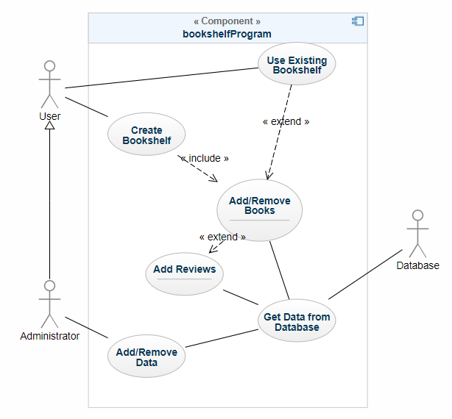
Example 1
Associative (SOLID LINE)
Generalization (SOLID LINE)
Include (LABELED DASHED LINE)
Extend (LABELED DASHED LINE)

Slide 5
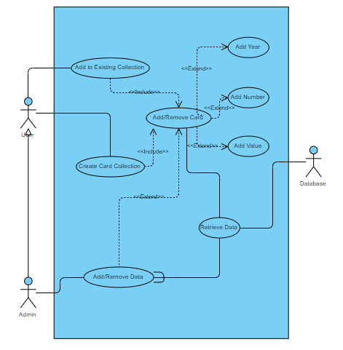
Example 2

